Slide 1
Image Classification
Deep Learning and Image Processing

Slide 2
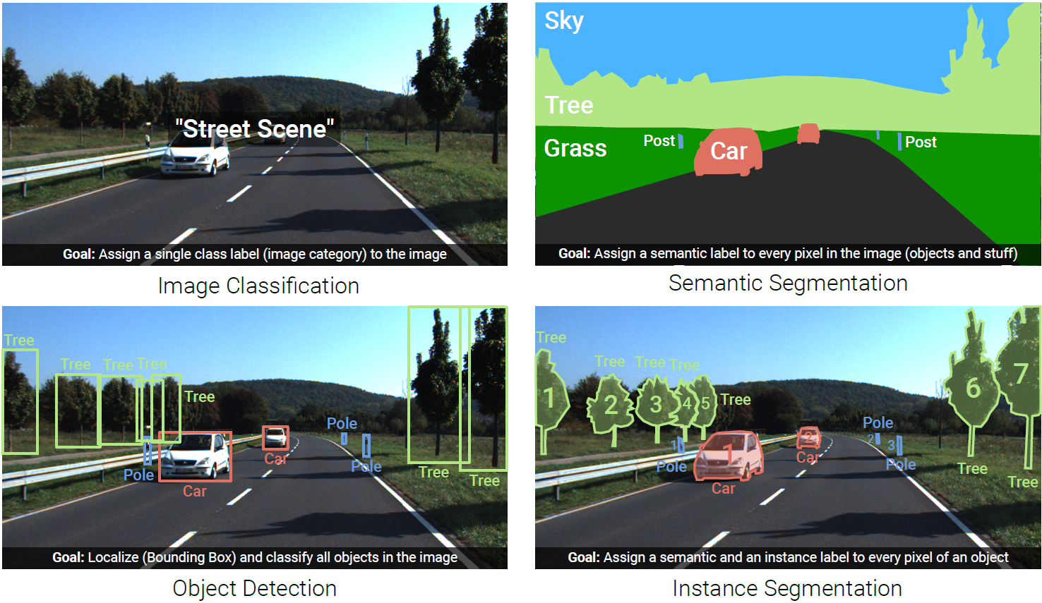
Image Understanding (Recognition)

Slide 3
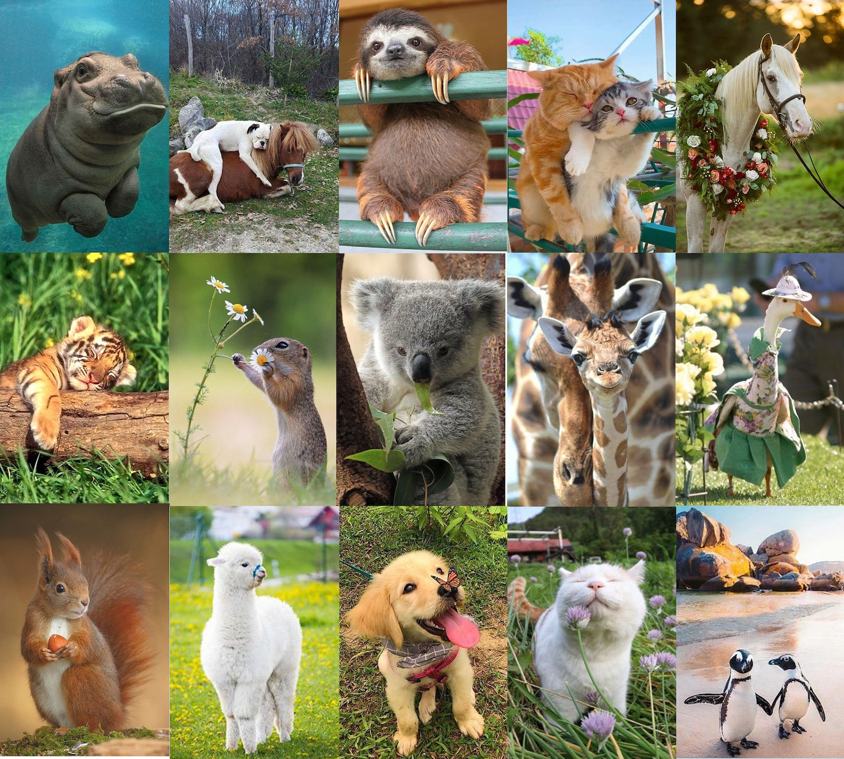
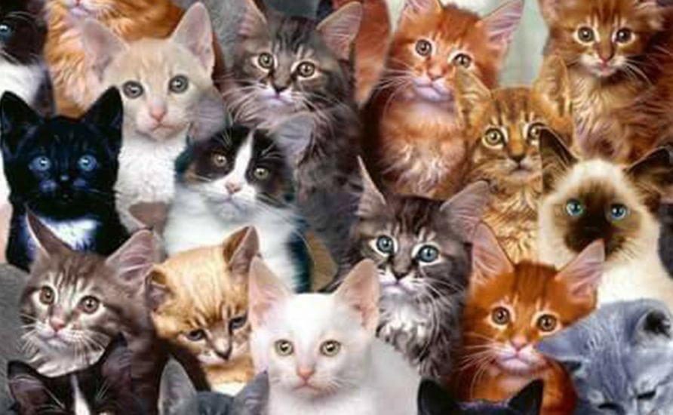
Need for ML
prime example (and also foundation for detection and segmentation):
image classification (whole-image class recognition) according to generic object categories (e.g., cat)
plain keypoint-feature matching only really works for specific instances of a class
→ need to compare with generic objects (e.g., kind of “abstract cat”)
Let’s learn it from data …
What if you haven’t seen this very cat before?

Slide 4
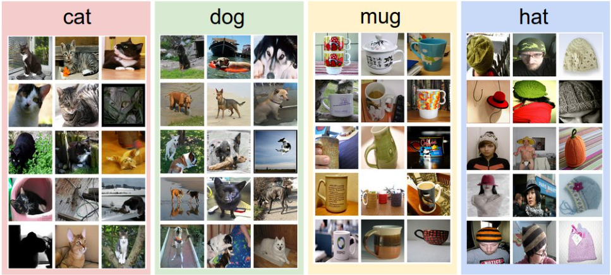
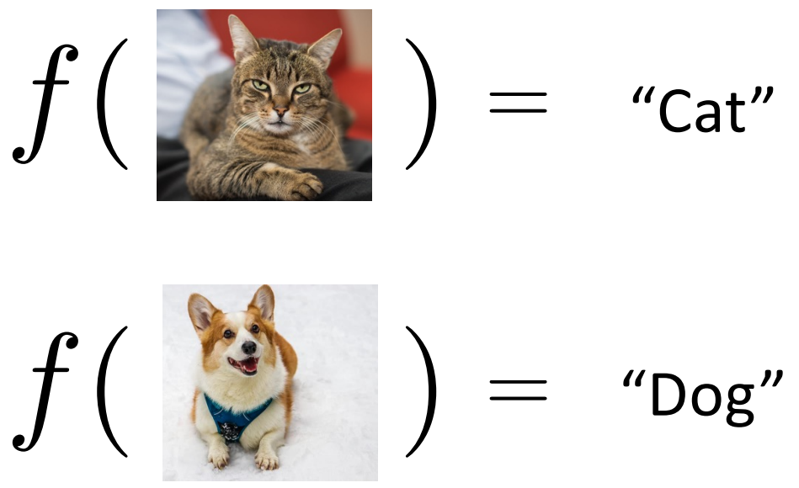
Image Classification
training data set:
test data with learned classifier:
labels:

Slide 5
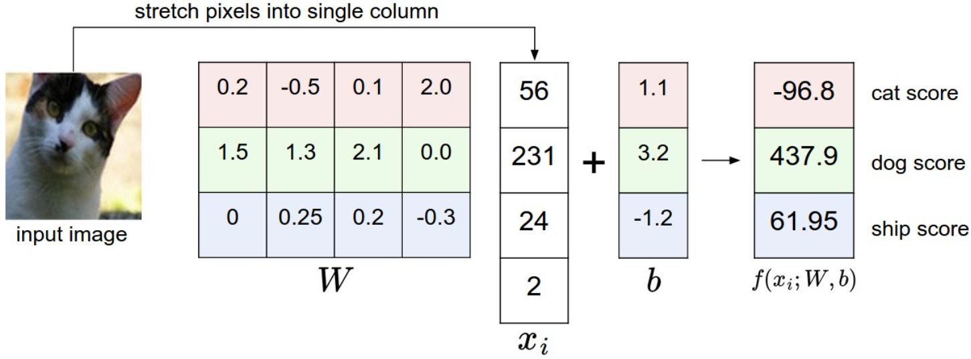
Image Classification with Linear Regression
simplified example: 4-pixel image, 3 classes
matrix
intensity values
need for one common image size per model

Slide 6
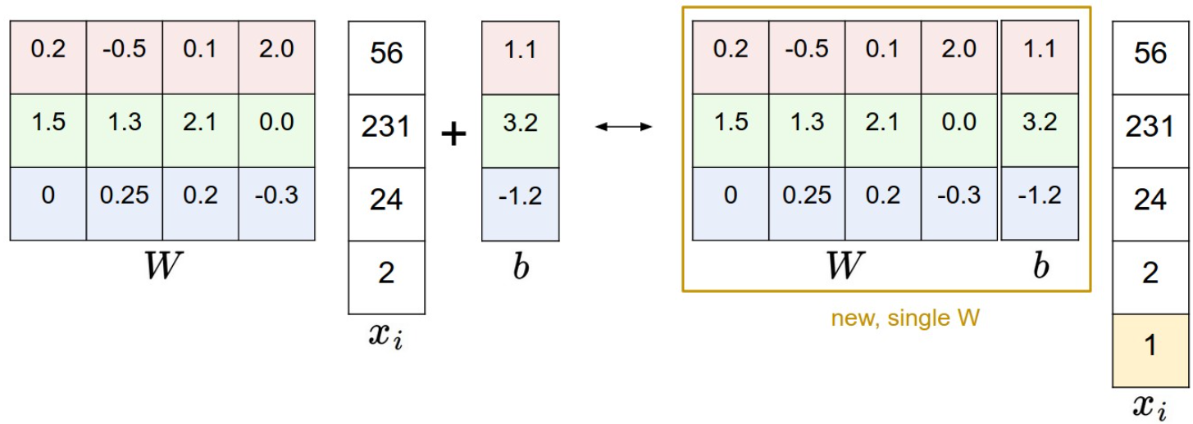
Simplified Matrix Multiplication: Bias Trick

Slide 7
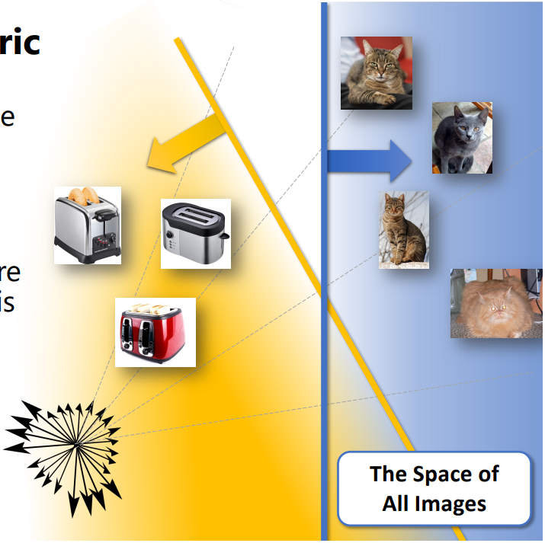
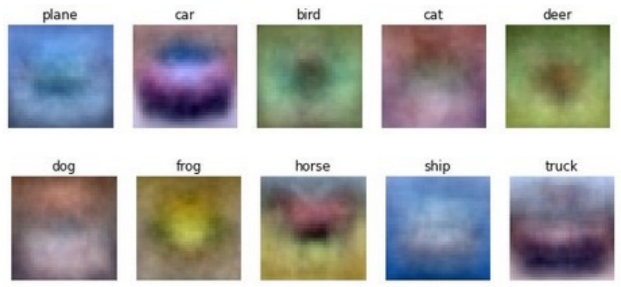
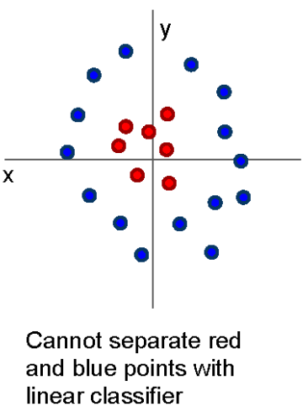
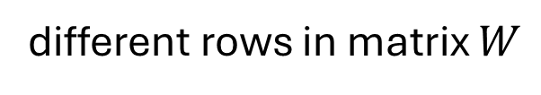
geometric interpretation:
separating hyperplanes
matching interpretation:
generic class templates
different rows in matrix $W$
raw-pixel images not linearly separable
→ linear model has not enough representational power

Slide 8
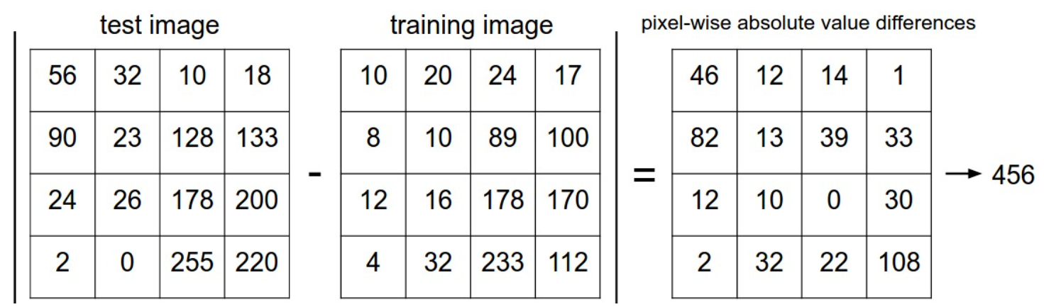

Image Classification with kNN
choose an image distance, e.g., L1 distance:
$$d\left(I_{1},I_{2}\right)=\sum_{p}{\left|I_{1}\left(p\right)−I_{2}\left(p\right)\right|}$$

Slide 9
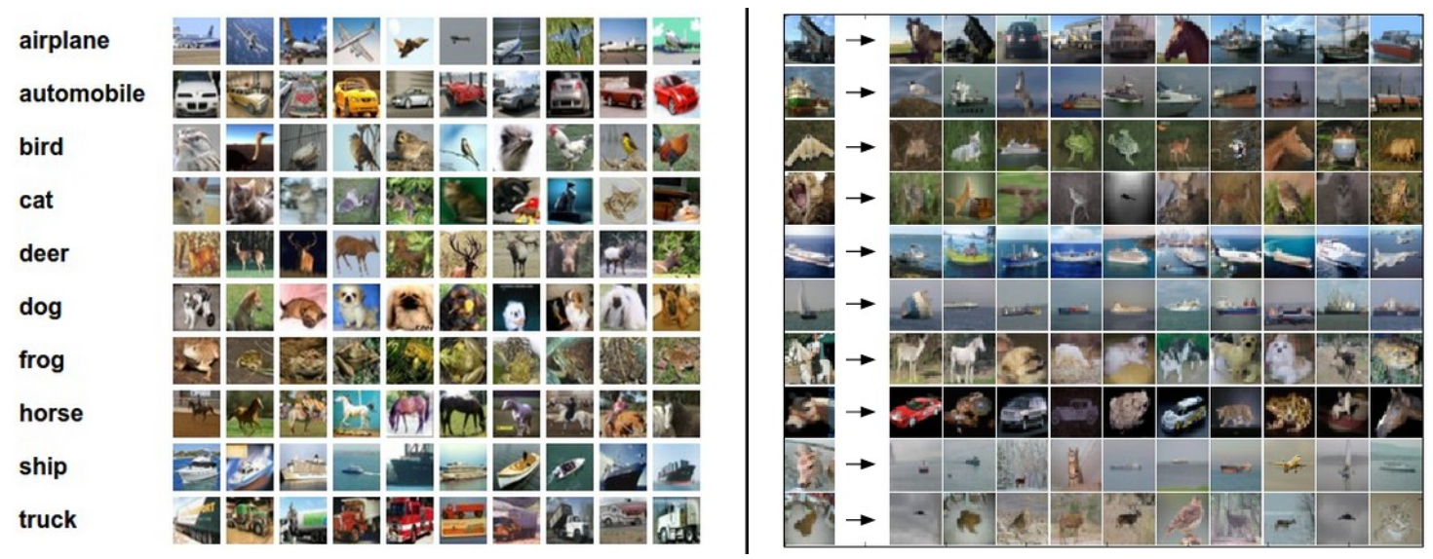
Image Classification with kNN
training examples CIFAR-10 data set
10 nearest neighbors to some test images
10 classes
better than random guessing, but also not very impressive

Slide 10
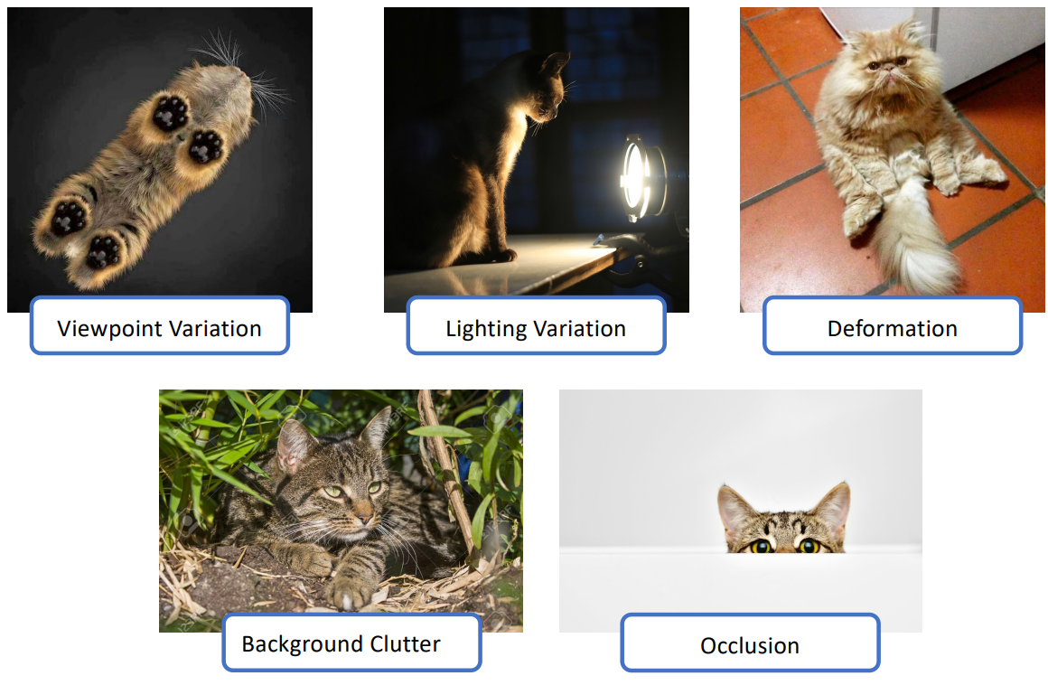
Which Features for Image Classification?
challenges:
linear regression & kNN (same for tree-based methods):
learning directly from raw pixel intensities does not work great
→ try learning from pre-extracted features, such as HOG or SIFT

Slide 11
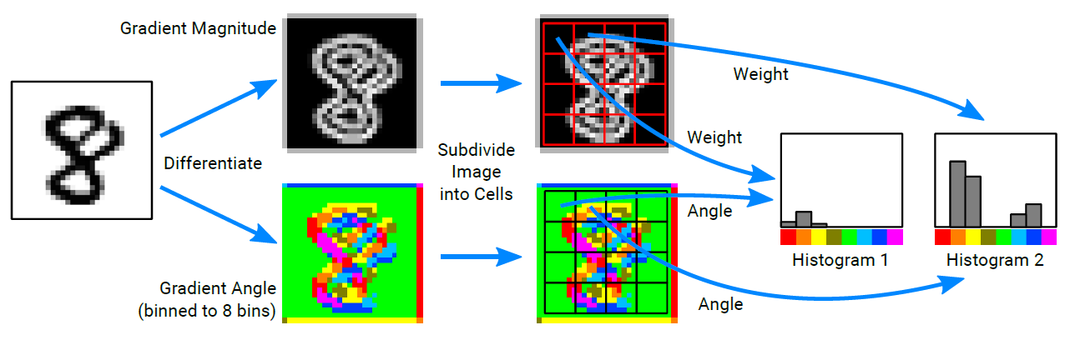
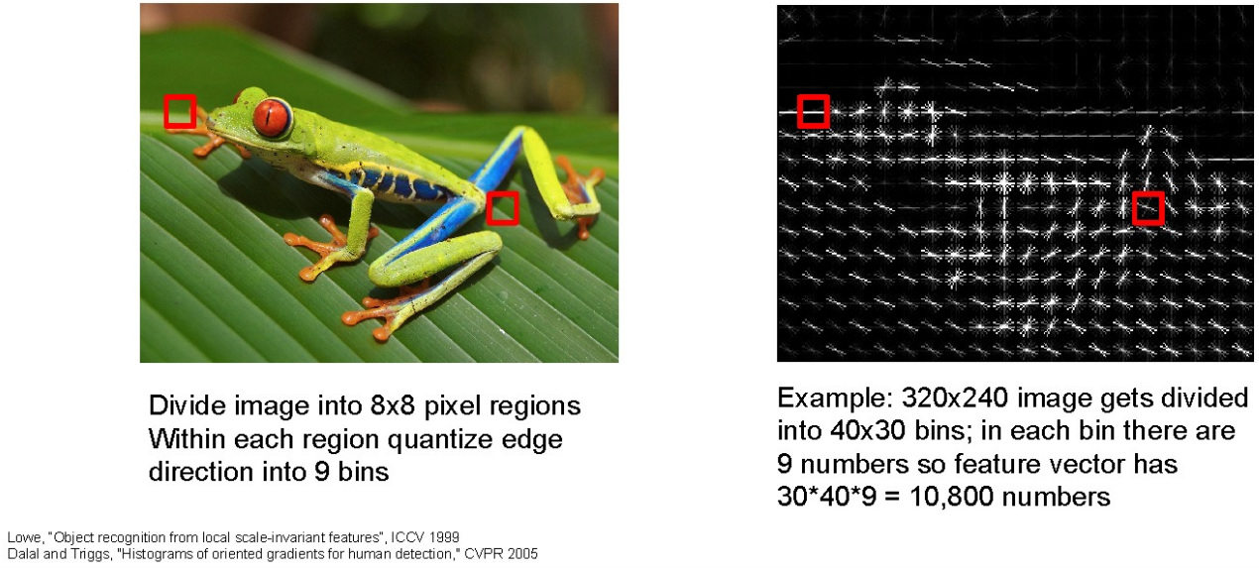
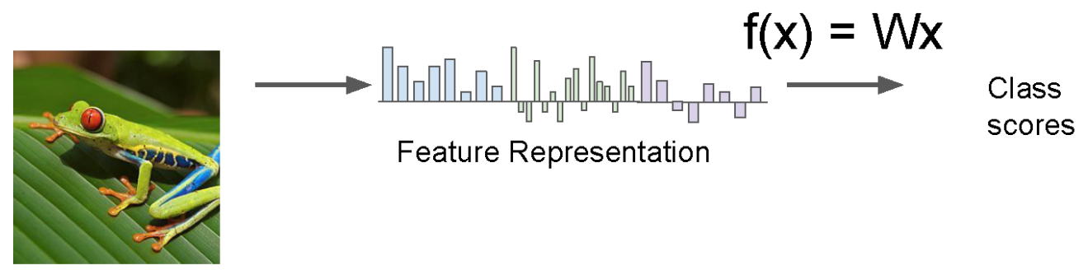
Global Features in Classic ML Method
often used: HOG
features covering entire image (instead of only local patches)
or random forest, support-vector machine, …
easier to separate than raw pixels
important disadvantage: not translation invariant (due to ordering of patches)

Slide 12
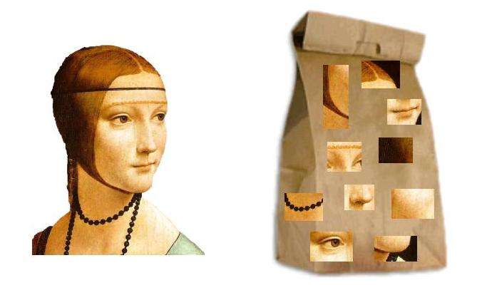
Local Features in Classic ML Method
local features like SIFT do not cover the entire image
→ need for some processing to identify features in different images (to be able to compare different images with ML)
in HOG this is done by ordering of patches making up the complete image
one popular approach, called bag-of-words model (as it is orderless):
learn clustering of SIFT vectors (e.g., with K-means)
quantization of different clusters into visual “vocabulary” (see embeddings in language models)
create (sparse) histogram of visual “word” occurrences
train ML model (e.g., random forest) with histogram bins as features
important disadvantage: ignores spatial relationships among different patches

Slide 13
Need for Feature Learning
many hand-designed components in approach using pre-extracted features → poor generalization
Is there maybe some way after all to learn features end-to-end from raw pixel intensities?

Slide 14
Image Data Sets

Slide 15
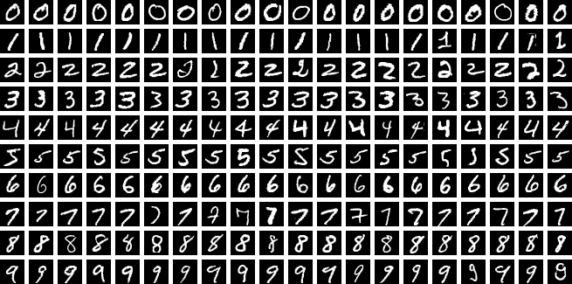
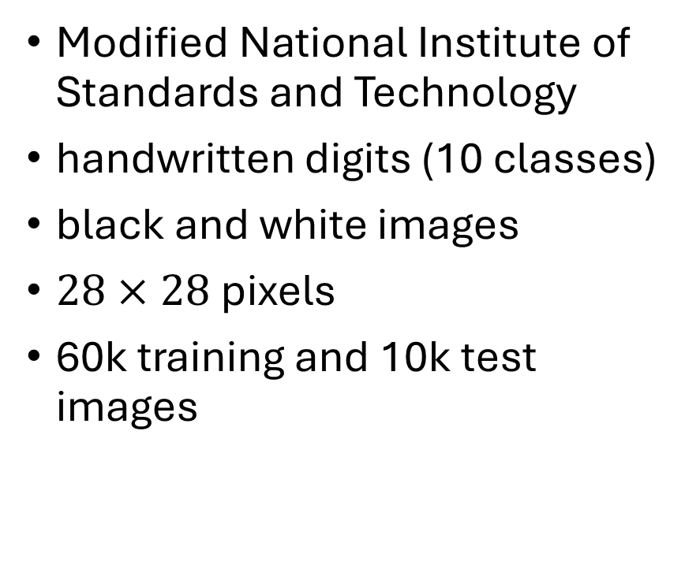
MNIST
Modified National Institute of Standards and Technology
handwritten digits (10 classes)
black and white images
$28×28$ pixels
60k training and 10k test images

Slide 16
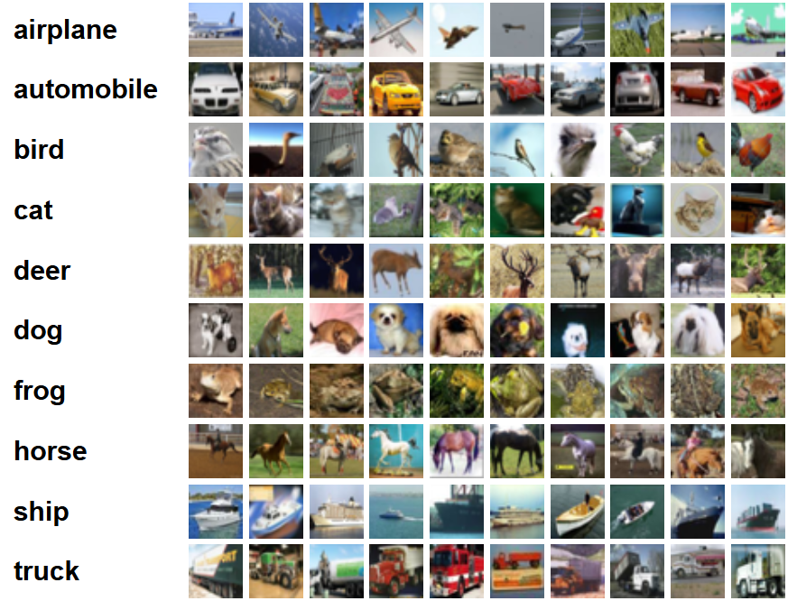
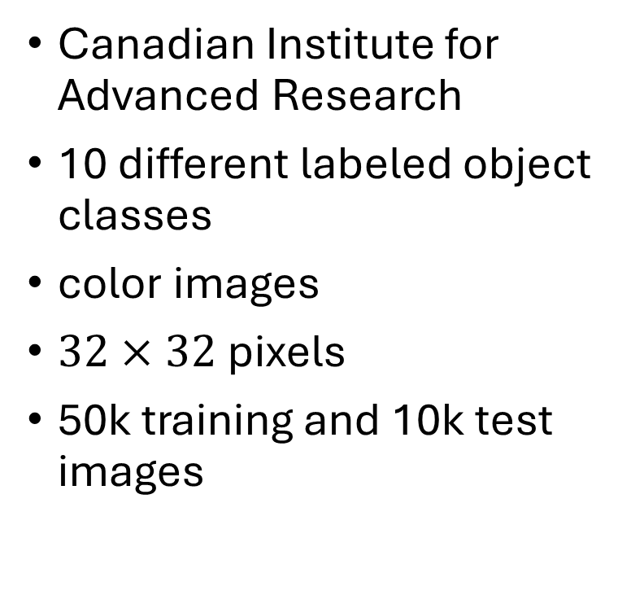
CIFAR-10
Canadian Institute for Advanced Research
10 different labeled object classes
color images
$32×32$ pixels
50k training and 10k test images

Slide 17
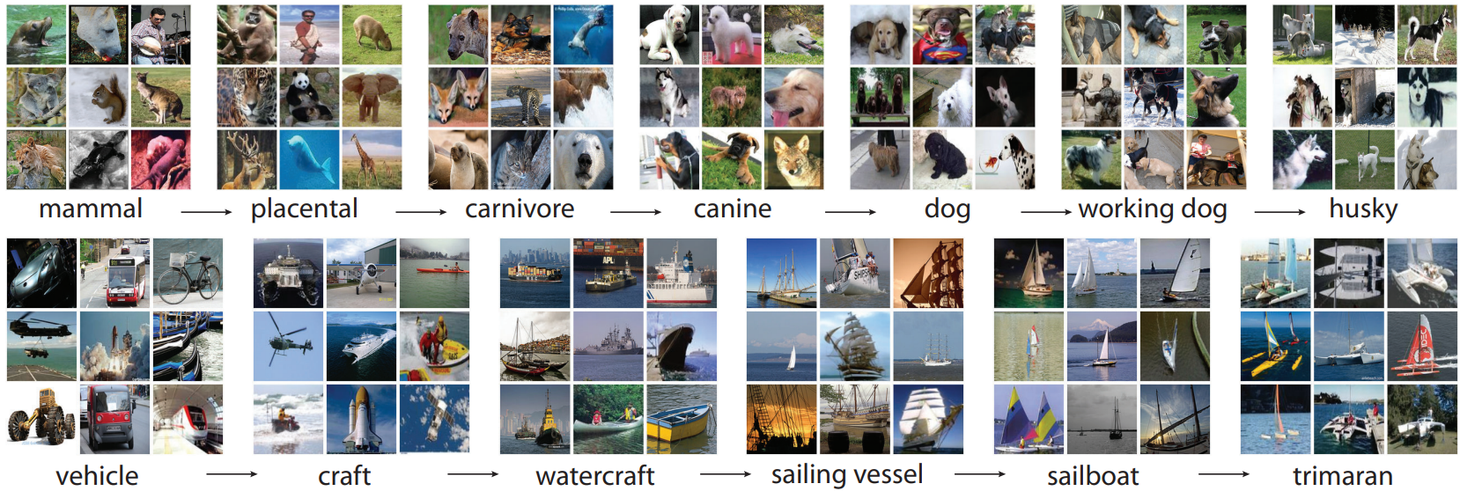
ImageNet
more than 14 million color images with varying sizes
more than 20k labeled categories

